Slide 1
Building Research Capacity in Social Care (Enablers and barriers facing practitioners in Wessex) (Enablers and barriers facing HEI academic staff in Wessex)
Seminar 2 / Part 3 / Methodology (20 mins)
15 June 2023

Slide 2
Aims of this part of the seminar
Provides an explanation of the methodology used and why.

Slide 3
Disclaimer
The views expressed are those of the author(s) and not necessarily those of the NIHR or CRN Wessex.

Slide 4
Acknowledgements and funding
The authors wish to thank all participants who took part in the online survey and gave up their time to be interviewed.
This work was supported by the Clinical Research Network (CRN) Wessex.

Slide 5
Aims of the project
Develop a better understanding of the:
Challenges of building capacity to undertake social care research in the Wessex region (Dorset, South Wiltshire, Hampshire and the Isle of Wight)
Opportunities for building research engagement and capacity.

Slide 6
Methodology – Mixed Methods
Research approved by a Bournemouth University Ethics panel
Practitioners - February 2022 (Ref: 41416)
HEI staff – March 2022 (Ref: 42232)
Two groups of participants were recruited.
Practitioners working in social care within the Wessex region (Dorset, BCP, South Wiltshire, Hampshire and the Isle of Wight).
Academics and researchers working in Higher Education Institutes (HEIs) within the Wessex region.

Slide 7
Practitioner recruitment
To promote awareness of the online survey, the researchers utilised Principal Social Worker (PSW) contacts at local authorities (LAs) within Wessex, academic and researcher contacts at local HEIs within Wessex and also recruited through online channels.
These included posts about the study on the National Centre for Post-Qualifying Social Work website and Twitter feeds and direct approaches to possible participants via LinkedIn.

Slide 8
Practitioner recruitment (2)
We made confirmed initial contact with n=182 practitioners from five different LAs.
Only practitioners working in LA social service departments were recruited rather than those working within the NHS due to ethical considerations.
Responses from n=22 practitioners working in social care within the Wessex region.

Slide 9
HEI staff recruitment
To promote awareness of the online survey, the researchers utilised HEI academic staff contacts at local HEIs within Wessex and also recruited through online channels.
These included posts about the study on the National Centre for Post-Qualifying Social Work website and Twitter feeds and direct approaches to possible participants via LinkedIn.
University specific channels were also utilised (via those working in Social Care research and academia).

Slide 10
HEI staff recruitment (2)
We made confirmed initial contact with n=38 HEI staff from four different HEIs.
Responses received from n=9 HEI academic staff working within the Wessex region.

Slide 11
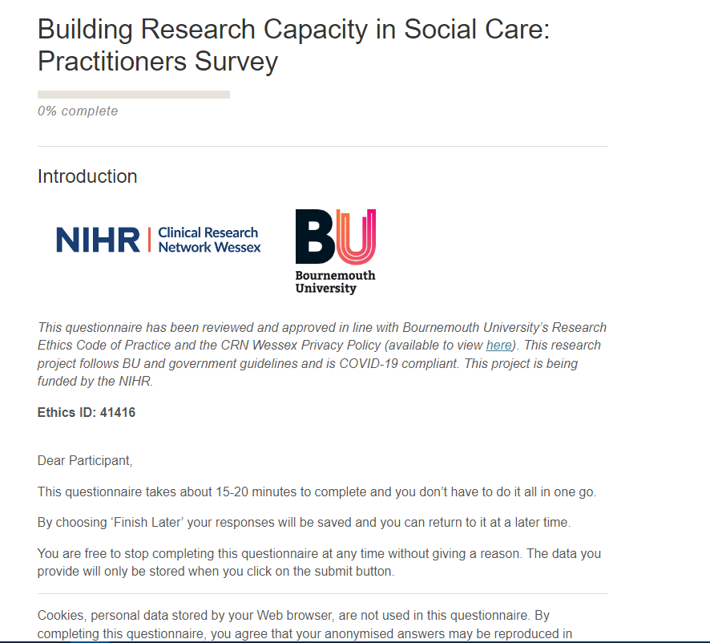
Online survey
All participants asked to complete an online questionnaire (taking around 15 to 20 minutes to complete).
Separate surveys for each group of participants.
Both utilised a mixture of quantitative and qualitative questions.

Slide 12
Practitioner survey
The practitioner questionnaire was designed to address following areas:
Workplace research capacity within LAs
Views on research
Experiences of research from a practitioner perspective
Training opportunities and support
Access to research materials and evidence
Past and future reflections on relevance and priority of research to practitioner roles

Slide 13
HEI Staff online survey
The HEI questionnaire was designed to address following areas:
Workplace research capacity within HEIs
Views on research
Experiences of research from an HEI perspective
Training support
Access to research materials and evidence
Past and future reflections on relevance and priority of research and research support to academic/researcher roles (and practitioner roles during interactions with/previous histories within these roles)

Slide 14
Practitioner interviews
A subsample of practitioners (n=6) were interviewed to collect positive and negative views of their experiences of research and of using research evidence in their job role.
Interview by telephone or online 1-to-1 meeting with video off.
A semi-structured interview schedule was constructed to collect positive and negative views of research experiences and of using research evidence.
Interviews were able to explore comments, observations and themes emerging from data collected in similar areas to the questionnaire as a starting point, before delving into more detail.

Slide 15
Practitioner interviews (2)
Example topics of discussion included:
workplace research capacity (sample mini-tour question: How much of your working week do you currently spend on research?)
views on and experiences of research (What does research mean to you?)
past and future reflections on the relevance and priority of research (What changes do you see occurring in the immediate future, concerning the relevance and priority of research in relation to your role?)

Slide 16
HEI staff interviews
A subsample of HEI academic staff (n=5) were interviewed to collect positive and negative views of their experiences to date of research and of supporting external research projects and staff in the course of their job.
Interview by telephone or online 1-to-1 meeting with video off.
A semi-structured interview schedule was constructed to collect positive and negative views of research experiences and of using research evidence.
Interviews were able to explore comments, observations and themes emerging from data collected in similar areas to the questionnaire as a starting point, before delving into more detail.

Slide 17
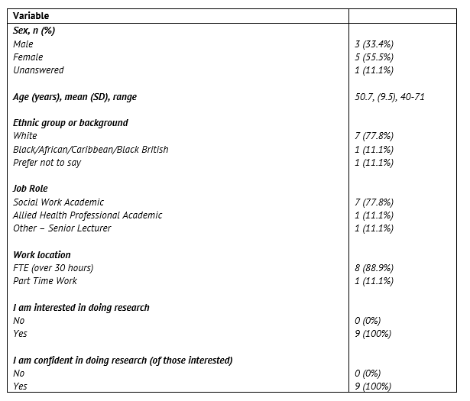
Data Analysis - Quantitative
Quantitative questionnaire data were analysed and summarised using descriptive statistics.
HEI staff data ==>

Slide 18
Data Analysis - Qualitative
A generic qualitative approach to thematic analysis was used (Caelli et al., 2016) with inter-researcher interpretation.
Following familiarization with the transcripts, a member of the team charted themes.
Subsequently, a second researcher familiarised themselves with the transcripts and the matrix of initial themes.

Slide 19
Data Analysis – Qualitative (2)
We developed an agreed coding scheme using an analytical framework that combined a priori issues from the original topic guide and emerging themes (Braun and Clarke, 2006).
Themes and sub-themes were identified and coded and then agreed between the two researchers.

Slide 20
e.g. Practitioner main themes
Enabler themes | Barrier themes
Individual-level (Personal) | Individual-level (Personal)
Organisational | Organisational
Logistical | Cultural
Research skills | Logistical
Access to research | Research skills
Research support | Access to research
 | Research support

Slide 21
e.g. Practitioner sub-themes
Barrier | Barrier themes | Barrier sub-themes | Example quotes
Organisational | Culture | Researching in free time not work time | So, I spent this whole bank holiday weekend writing out all my bit, that I was interested in following up… [P107 FI]
 | Structure | Research is low priority | In some ways I feel we are told how to work depending on the resources we have available to us as opposed to research what might be the best way for the person to achieve their outcomes. [P108]
 |  | Austerity and budgetary constraints | I think there’s a financial restraint in terms of people’s time to do it…I think there’s been so much of a squeeze that they need to kind of go ‘Is that a priority for us financially?’ [P108 FI]
 |  | COVID-19 – staff leaving | …I know, several people who have sort of gone: ‘No thanks! I’m done. I’m gonna go and do something else’…and so they have unfortunately - whether permanently or not – but they have sort of stepped away from the profession to do something else… [P108 FI]

Slide 22
Methodology – Why this approach?
Putting yourself into the place of the participants….
Social
Care
Research
HEI Academic Staff
Practitioners

Slide 23
Limitations
This study may have been affected by respondent selection and bias.
Participation was on a voluntary basis and respondents were self-selecting, on the basis that people with views they would like to communicate were more likely to participate.
The study took place in one UK region, was a qualitative, explorative study and had a limited sample size, so findings may not be nationally typical and should be generalized with caution.

Slide 24
Limitations (2)
Reasons for obtaining qualitative data from a smaller sample than originally anticipated might include apathy, survey fatigue or concerns of privacy surrounding sharing personal information concerning workplace experiences with an external researcher.
In terms of publicising the surveys for this project, the research team encountered many difficulties in contacting our recruitment targets.
Innovative methods of direct contact - such as connecting through LinkedIn for study recruitment - proved much more effective as a recruitment tool than other methods.

Slide 25
Limitations (3)
In a busy and stressful environment, practitioners (especially) and HEI staff (occasionally) are often:
not in receipt of information sent through internal email
might choose to ignore emails
might not have the time or inclination to seek out information via websites

Slide 26
Limitations (4)
Harnessing innovative methods of direct contact – an effective recruitment tool in this study (Stokes et al., 2019) - such as directly connecting through LinkedIn or other social media platforms offers…
…positive opportunities to form and maintain more direct channels of communication with those research positive practitioners looking for information, inspiration or support.

Slide 27
Any questions?
We now should have around 15 minutes for a general discussion or any questions….(unless I’ve overrun ☹ )

Slide 28
Further reading
Pulman, A. and Fenge, L. A., 2023. Building Capacity for Social Care Research—Individual-Level and Organisational Barriers Facing Practitioners. The British Journal of Social Work. https://doi.org/10.1093/bjsw/bcad117
Pulman, A. and Fenge, L.A., 2023. Building Capacity for Social Care Research – Ways of Improving Research Skills for Social Workers. Social Work Education. https://doi.org/10.1080/02615479.2023.2221276
Not accessible? Then head to: https://staffprofiles.bournemouth.ac.uk/display/apulman#publications
You can also visit us at: https://ncpqsw.com/building-research-capacity-in-social-care/

Slide 29
References
Braun V, Clarke V. (2006) Using thematic analysis in psychology. Qual Res Psychol, Jan 3(2), pp. 77-101.
Caelli, K., Ray L. and Mill J. (2016) ‘'Clear as mud': toward greater clarity in generic qualitative research’. Int J Qual Methods, 2(2), pp. 1-13.
Department of Health. (1994) A Wider Strategy for Research and Development Relating to Personal Social Services: Report to the Director of Research and Development, Department of Health, by an Independent Review Group. (The Gilbert Report) London, Department of Health.
Geoghegan, L. and Fenge, L. A. (2022) What social care research is and why it is important: Podcast, available online at: https://www.emeraldgrouppublishing.com/podcast-what-social-care-research-and-why-it-important (accessed March 27, 2023).
Moriarty, J., Manthorpe, J., Stevens, M., & Hussein, S. (2015). Educators or researchers? Barriers and facilitators to undertaking research among UK social work academics. The British Journal of Social Work, 45(6), 1659-1677.

Slide 30
References (2)
NIHR Funding and Awards. (2020) HS&DR Adult Social Care Funding Committee Public Minutes October 2020. NIHR, available online at: https://www.nihr.ac.uk/documents/hsanddr-adult-social-care-funding-committee-public-minutes-october-2020/26283 (accessed March 27, 2023).
Research Advisory Group for the Chief Social Worker for Adults. (2023) A Charter for Social Work Research in Adult Social Care. Birmingham: BASW, available online at: https://www.basw.co.uk/resources/charter-social-work-research-adult-social-care (accessed March 27, 2023).
Stokes, Y., Vandyk, A., Squires, J., Jacob, J. D., and Gifford, W. (2019) ‘Using Facebook and LinkedIn to recruit nurses for an online survey’. Western journal of nursing research, 41(1), pp. 96-110.
Teater, B., Lefevre, M., & McLaughlin, H. (2018). Research activity among UK social work academics. Journal of Social Work, 18(1), 85-106.

Slide 31
Contact details
Dr Andy Pulman
Email: apulman@bournemouth.ac.uk Staff Details: https://staffprofiles.bournemouth.ac.uk/display/apulman
Our home on the NCPQSW website also contains details on our current Adult Social Care Recruitment and Retention research project.
Web: https://ncpqsw.com/building-research-capacity-in-social-care/
(or just google PQSW)

